Slide 1
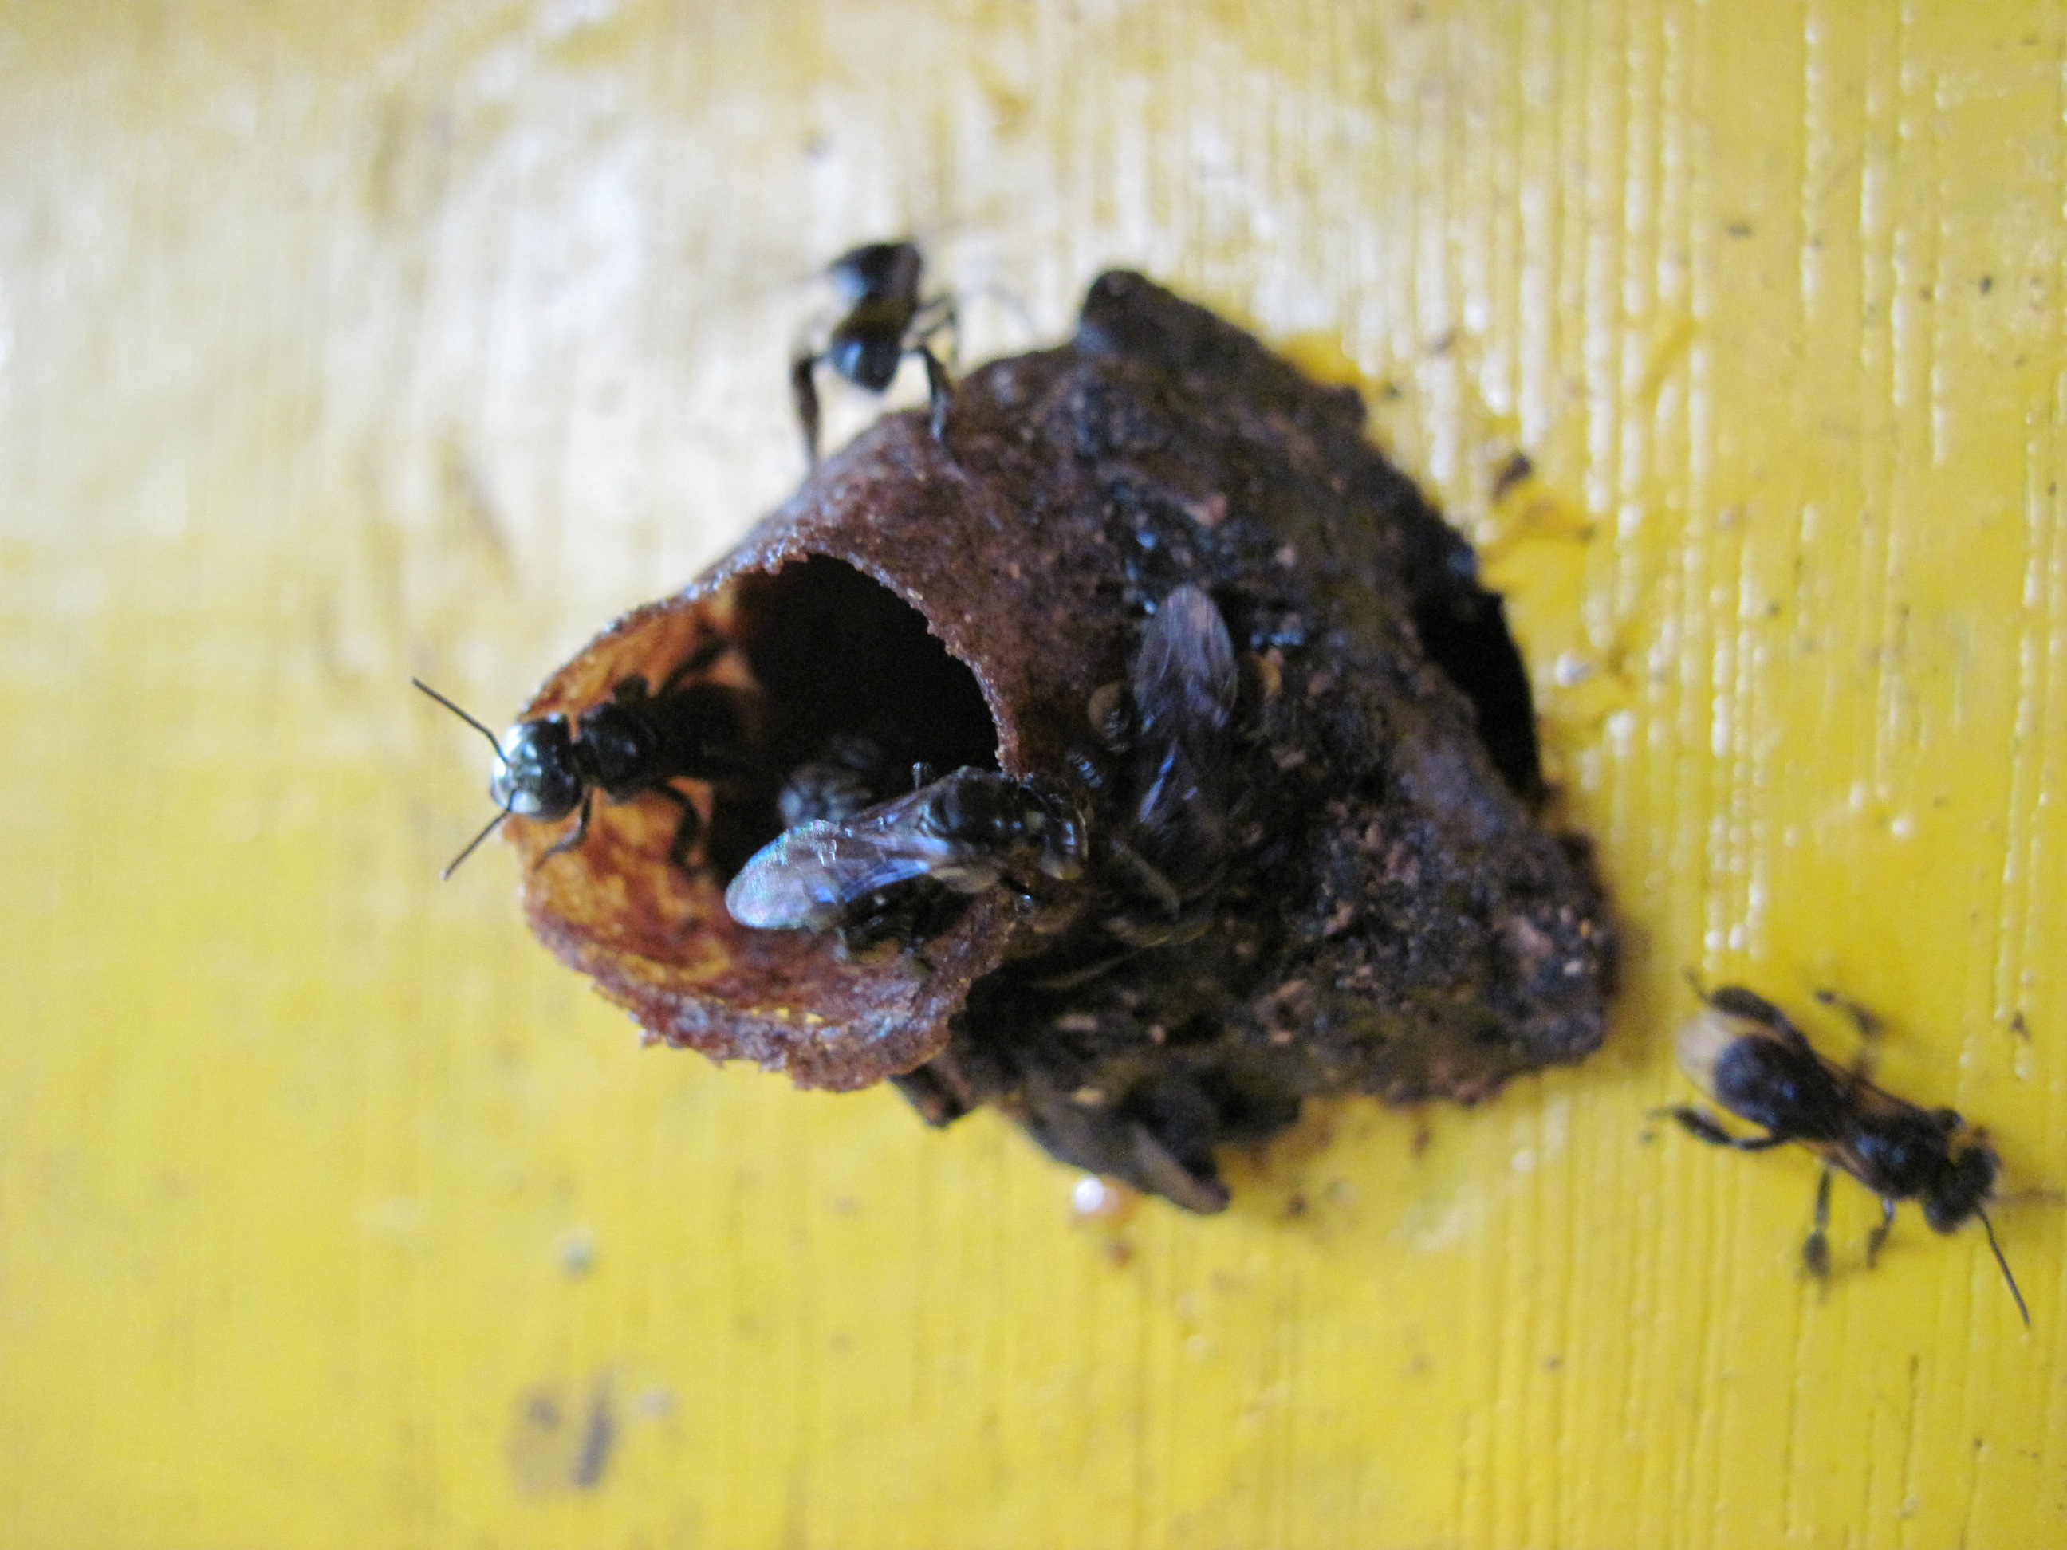
Madu Kelulut Amaravilla
Present By:
Muhammad Afif Hamizan Bin Noor Azam
(2017513057)
Muhammad Eizlan Bin Md Arif
(2017164243)
Amier Haziq Bin Mohd Ramli
(2017310299)
Nurirfan Farhan Bin Mohd Muzamir
(2017500695)
Muhammad Afidzam Bin Rosli
(2017163695)

Slide 2
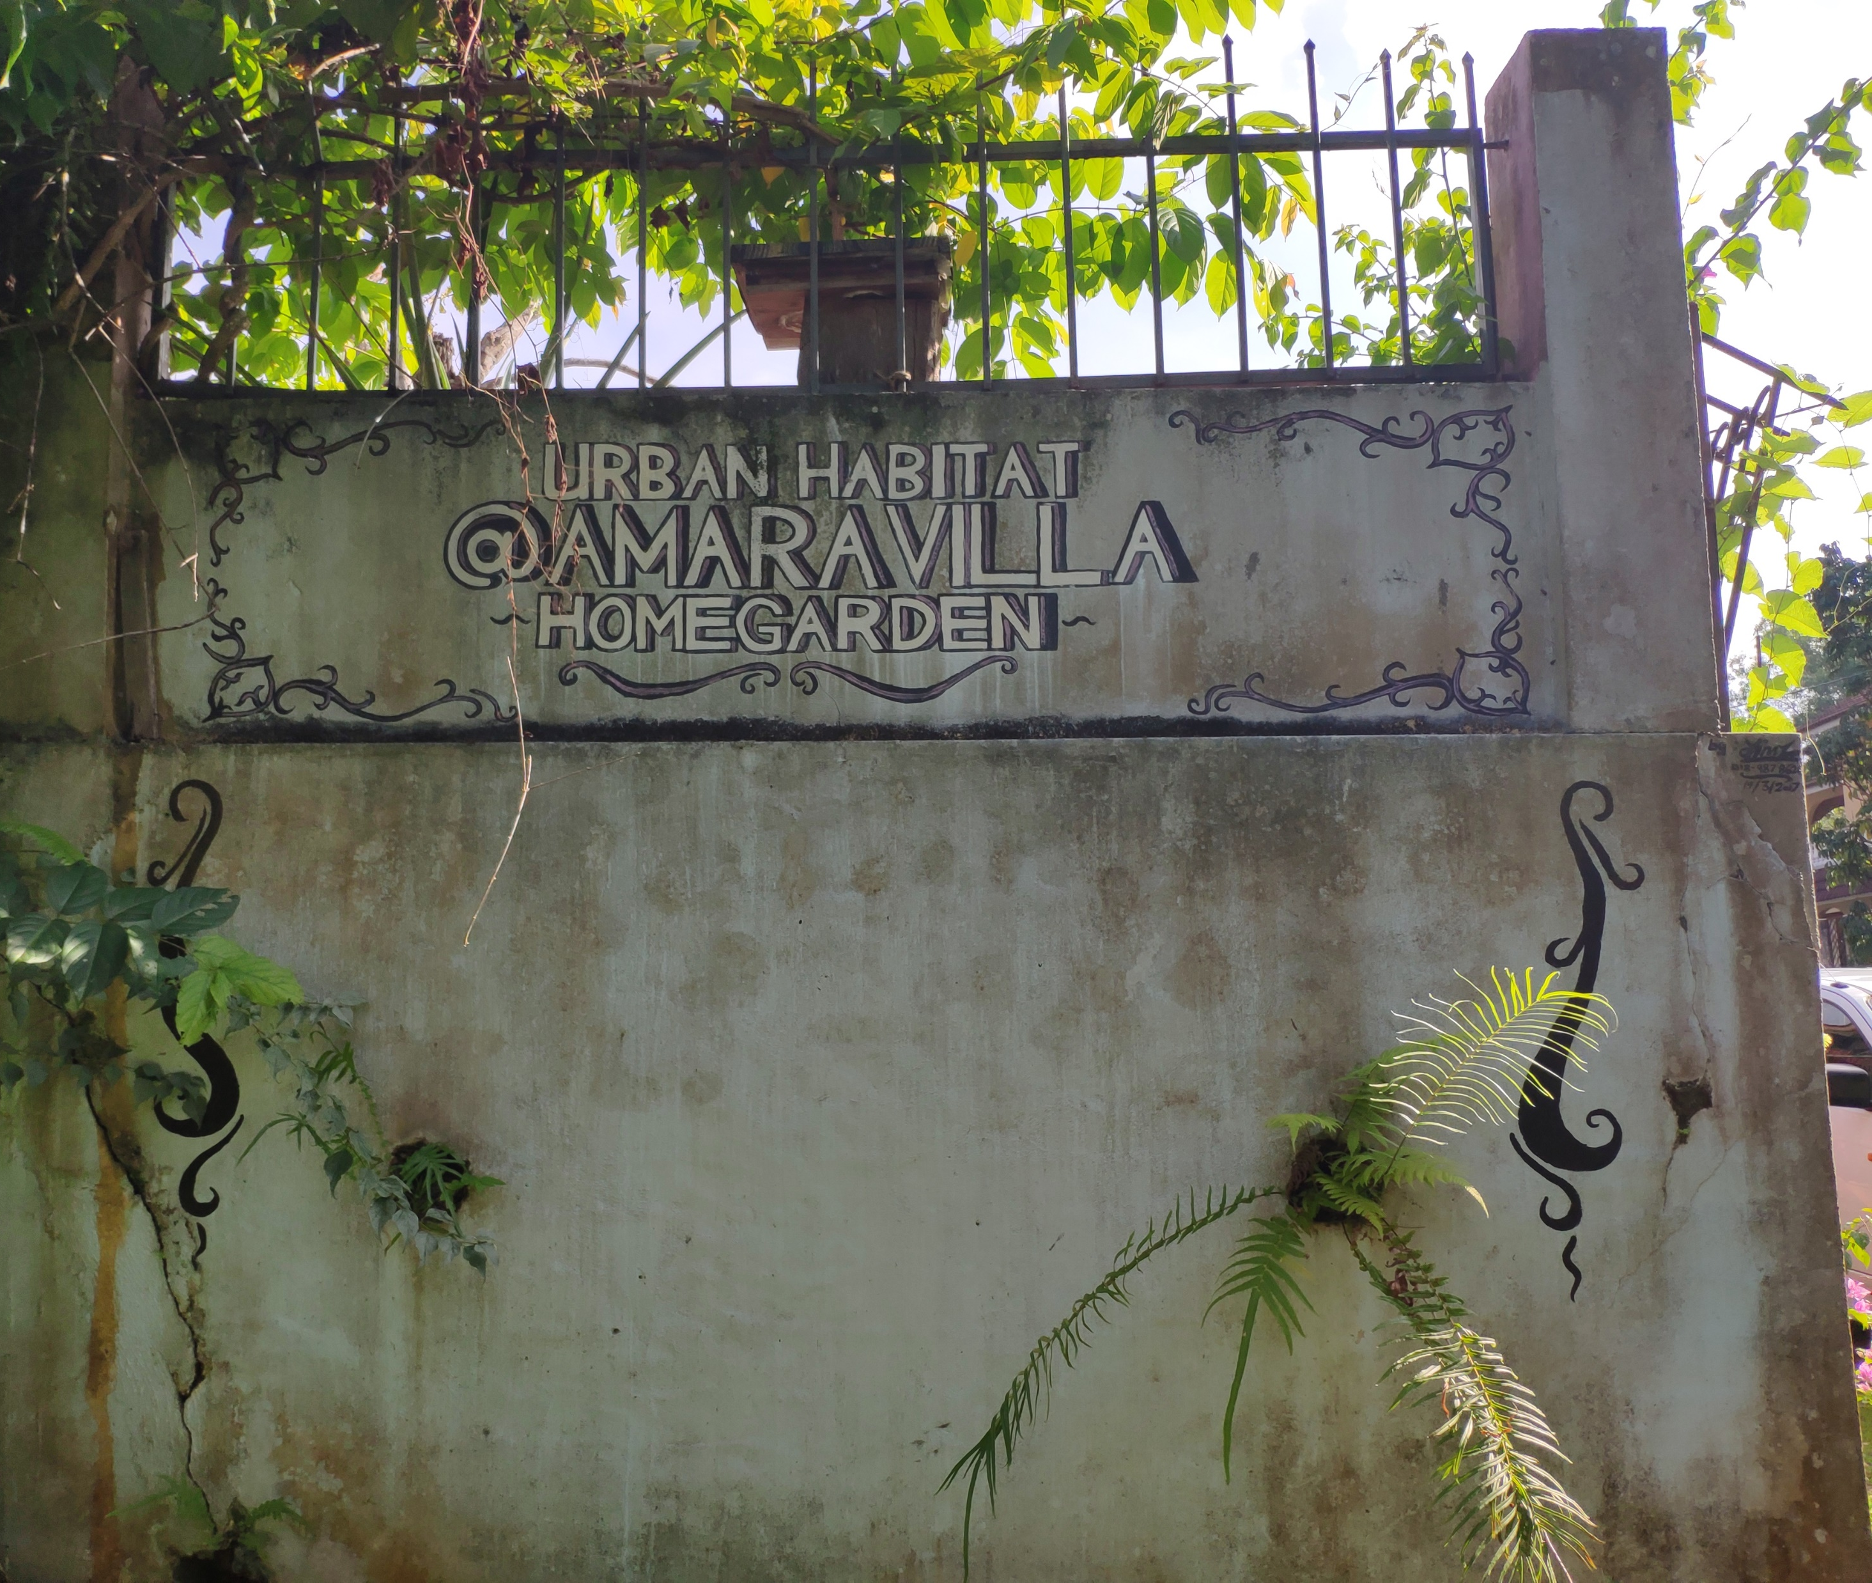
INTRODUCTION
Madu Kelulut Amaravilla is a truly unique beekeping farm especially the Stingless Bee species such as Itama, Thoracica and Terminata bees. Next, Amaravilla practiced the concept of “Home Garden” which is the bees was breed in a beautiful garden that imitates their natural habitat usually located in a forest. Moreover, the other uniqueness of the Amaravilla Homegarden is Amaravilla’s harvested raw honey will not be dried in order to maintain their product authenticity.

Slide 3

Nature Of Business
LOGO OF MADU KELULUT AMARAVILLA
The Amaravilla Homegarden offers to their customer the most authentic raw honey that specially harvested directly from the Stingless Bees or as we known as “Lebah Kelulut”. In addition, Amaravilla Homegarden prioritize mainly on maintaining the purity of their honey because the honey itself is unheated and untreated to maintain the goodness contains in their honey.

Slide 4
Background Of The Website
The website is a business website. It has been developed with the use of html and css. Css is the one who will control the styles of this website and html is the one who controls the main codings for the website. The background for this website is white and gray and theres a banner image.

Slide 5
User Experience and User Interface Of The Website
User Experience
-Responsive & mobile friendly
The website is responsive and even the mobile phone can search the website
-Well Designed headings
The headings of the website is purposeful and also well organized
-Optimized page speed
The loading time for each page is fast as it is a scrollable website.
User Interface
-Navigational components provided
Icon and hyperlink text provided as a navigation tools in the website
-Strategic colour and texture
The colour and the texture that has been use for this website is suitable with the content
-Typography
The text that has been use is simple and readable
-Consistence
The website uses the same type of font according to each element.

Slide 6
Color Scheme Used
The use of bright accent color can be seen throughout the website. This type of color is pleasing to the eyes. The website use yellow as the main color for all headings as a reference to bees. Other than that, the website uses any color that can help the visitors to read the contents easily.

Slide 7
Navigation Of The Website
The visitors or users can browse through the website easily as the navigation of the website is comprehensible.
For example, the navigation bar can be easily understandable by the visitors.
There is also a map where the visitors can go to google map and locate the whereabouts of Amaravilla Madu Kelulut.

Slide 8
Conclusion
As a conclusion, we can conclude that this website is really suitable for business it is because the navigation of the website are simple enough for the users to navigate through the website. Although the navigation of the website are quite simple, it is yet met all of the requirements that a website needed such as the colour usage and the font headings.

